Slide 1
@ L.E. Robotics (Pvt.) Ltd.

Slide 2
Contents
Description of the Organization
Description of Familiarization work carried out
Exposure to Other Departments
Project Work
Hands-on Experiences
Soft Skills Development
SWOT Analysis of the Organization and Self
Conclusion

Slide 3
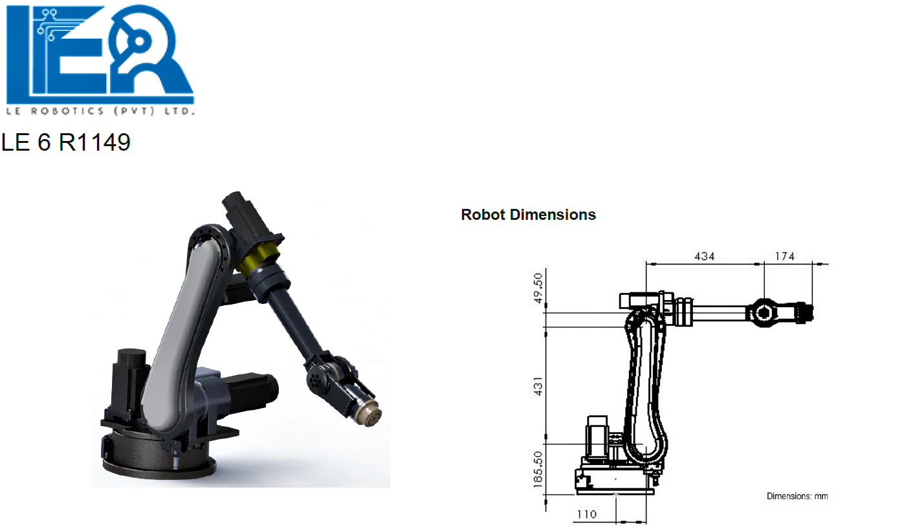
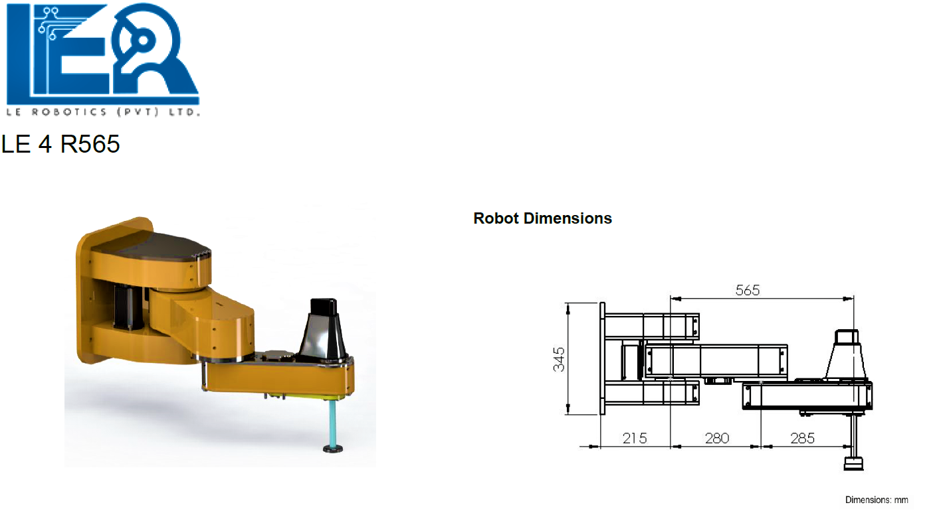
Description of the Organization
L.E. Robotics (Pvt.) Ltd. is a local R&D facility located in Minuwangoda, Sri Lanka.
Offers fully customisable robotics solutions for various automation needs
Established in 2005 by Prof. J.A.K.S. Jayasinghe who is a senior professor in ENTC
Products manufactured:
6 DOF Robots - Robots with six degrees of freedom
4 DOF Robots - Robots with four degrees of freedom
R&D of the related technologies (servo motors and their drivers)

Slide 4
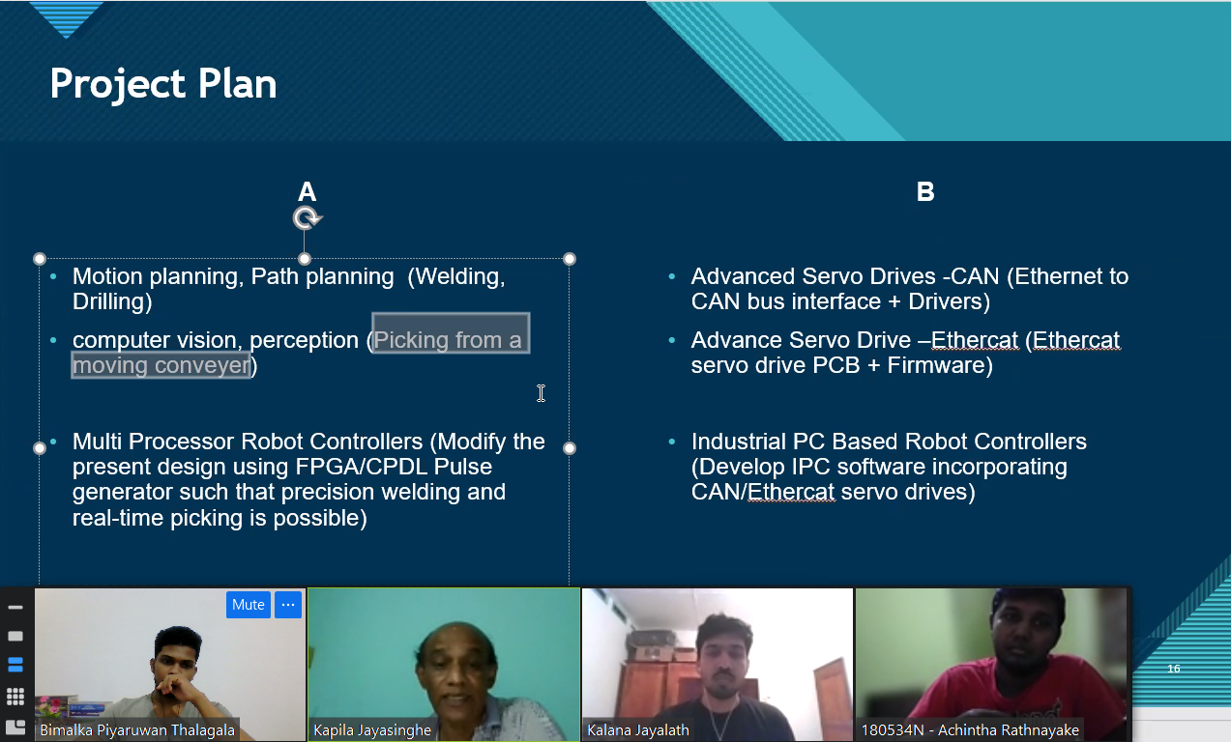
Familiarization work carried out
Projects Assignment was done about a month prior to the commencement of internship
two project plans were offered
we agreed to move forward with plan A (on left)
Facility familiarization after commencement of the internship
introduction to industrial robot arm designing
machinery required for industrial robot arm designing (CNC,Lathe,…)
Non-Disclosure agreement

Slide 5
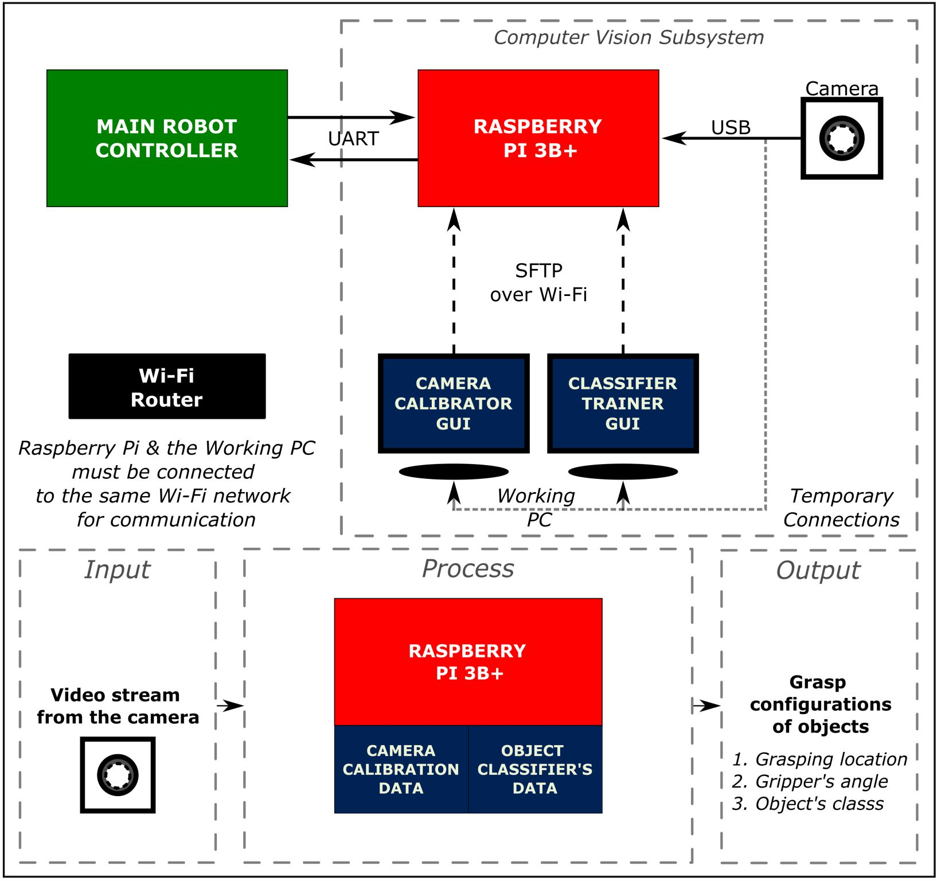
Project Work
By title, the project that I was assigned, was “Machine vision based Real-time Motion Planning for an Industrial Articulated Robot Arm”.
My contribution to that project
Developed an object detection framework
Developed an application for camera calibration (Camera Calib. GUI)
Developed an application to train an object classification model (Classifier Trainer GUI)

Slide 6
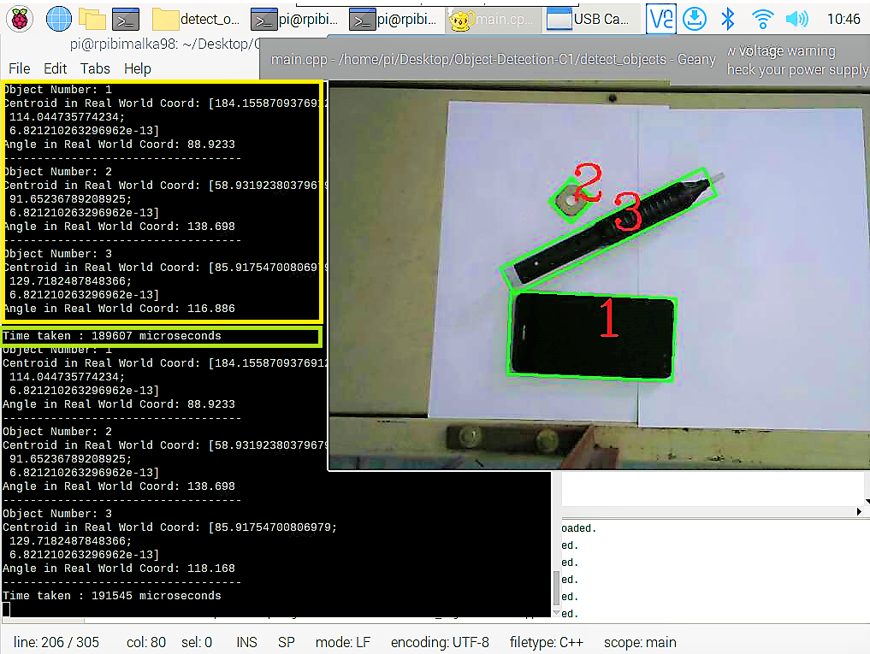
Object Detection Framework
Engineered from scratch
Developed two associated Windows GUIs (coming up next)
Capable of determining grasping configurations (location, orientation and object class) for a given object
Implemented all the algorithms using C++ and OpenCV (a traditional Computer Vision approach)
Documented working principles and guidelines to deploy the framework to the vision subsystem of pick and place machine

Slide 7
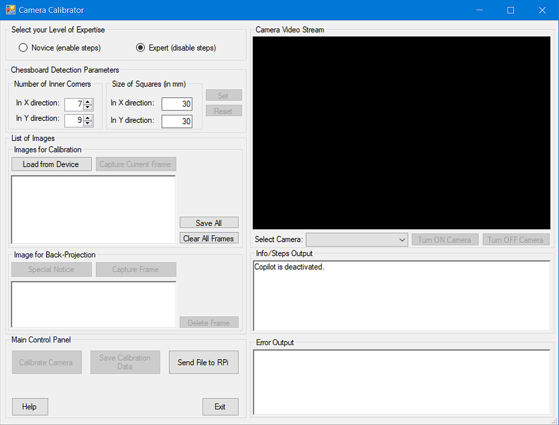
Camera Calibrator GUI
Designed the user interface
Developed required algorithms using C# and Emgu CV
Composed the user manual for the software.
Can be used to calibrate any monocular camera to be used in automatic pick and place machines
Application is capable of generating required data, to remove the distortions of captured images to transform 2D image points back to a given 3D real world coordinate system with an accuracy of ± 0.5 mm.

Slide 8
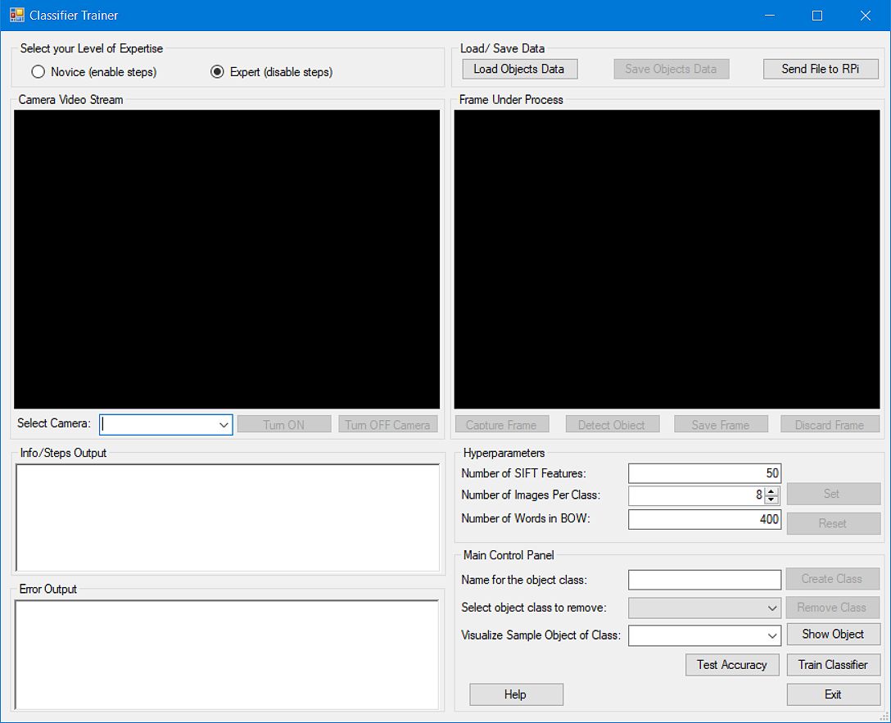
Classifier Trainer GUI
Designed the user interface
Implemented required algorithms using C# and Emgu CV
Trained and tested the accuracy of the model on industrial robot parts classification
Composed software’s user manual
Classification model uses, SIFT for feature extraction; K-Means clustering to create the Bag of Words (BOW); and Support Vector Machines (SVMs) for classification in One-vs-All approach.

Slide 9
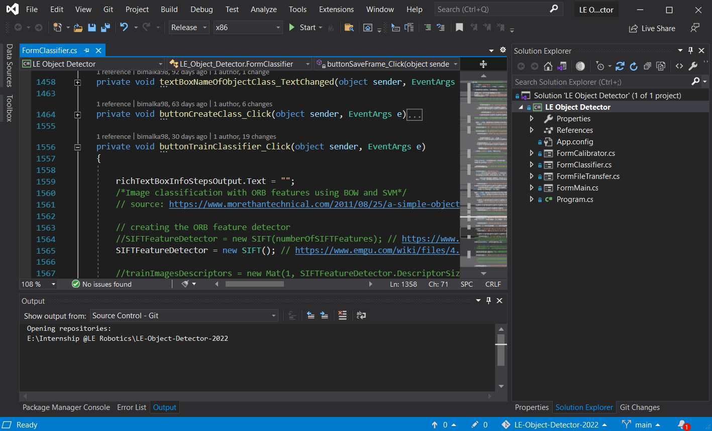
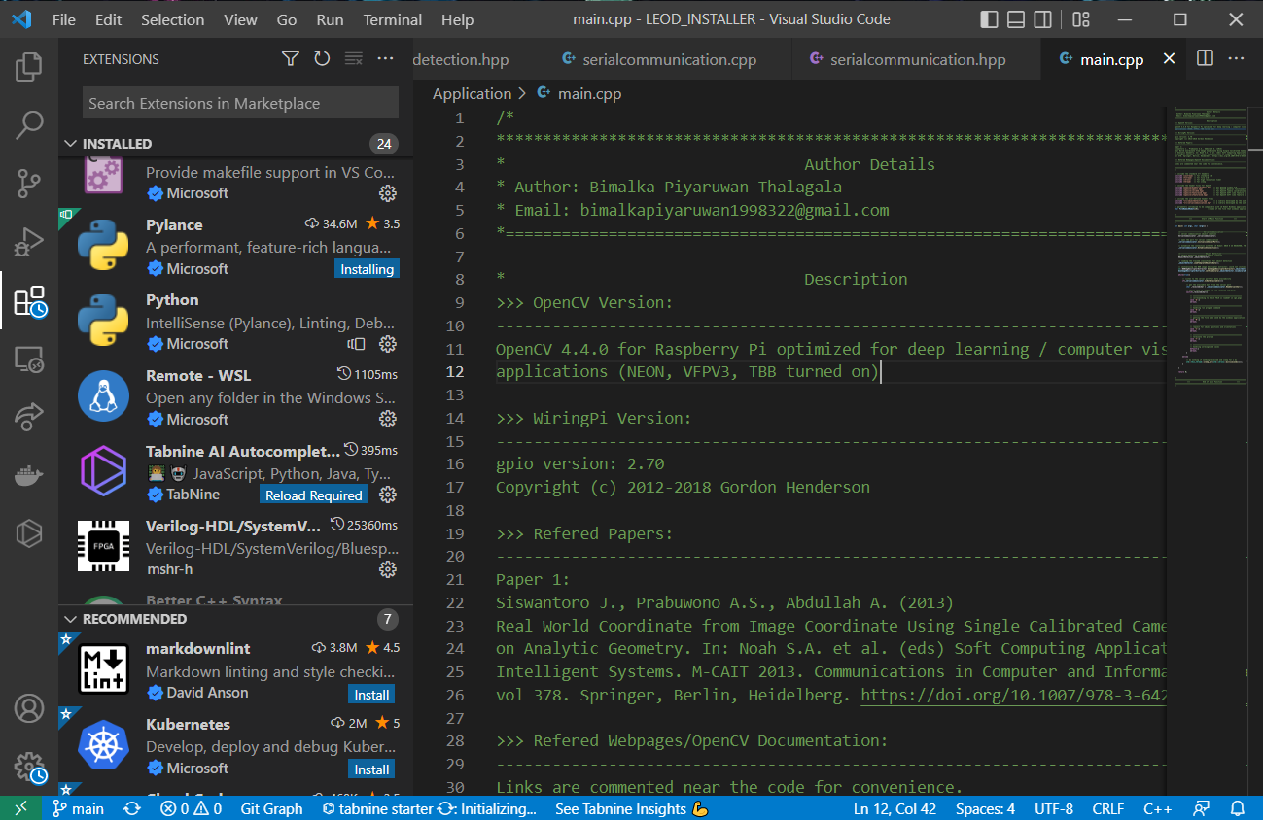


Hands-on Experiences
LE robotics Pvt. Ltd. had no experts in the CV field. I had to learn most of the things related to my assigned projects by actually doing them.
An ideal opportunity to learn, unlearn and relearn various technologies really fast and with minimum supervision.
Resources for Self-Learning
Google Search • Stack Overflow • OpenCV Documentations • EmguCV Documentations • Research Publications
Usage of Open Source Software
Usage of Modern Tools (CV & SE related)
Visual Studio 2019 • Visual Studio Code • Git • CMake

Slide 10
Soft Skills Development
Learning a new technical skill is not a big deal with the advancements in technology as everything is available at the fingertip
However, mastering a soft skill is much harder and takes time
LE Robotics Pvt. Ltd. was absolutely an ideal place to improve existing soft skills as well as to learn a new set of soft skills
Problem-solving: exposure to the world of ‘Research publications’, exposure to entire prototype development process (idea generation, research, planning and prototyping)
Adaptability: Companies and working environments are different from one another, have to deal with human beings with diverse mindsets
Time management: Proper planning and organization of the assigned tasks depending on their priority, knowledge of modern tools was also a plus point
Professional work ethic: Punctuality, Trustworthiness and obeying the NDAs, Respect the Intellectual Property (IP) of others
Communication : project demonstrations, various presentations and technical documentation preparations

Slide 11
SWOT Analysis
Organization
Self
S
Great vision towards “Made in Sri Lanka”
Decades of experience in the industry
R&D of very advanced technologies
Can work under minimum supervision
A team player with critical thinking abilities
Fast learner who learns as needed
W
Heavily depends on the interns
Well-being or the career growth of the employees was not of their concern
Underestimate myself when a new challenge is introduced
Can not tolerate any kind of injustice
O
Industrial automation is a fast growing field
Very few competitors in the market
Industrial automation is a fast growing field
Professionals with both AI and Embedded Systems Engineering knowledge have a higher demand
T
Slow product development speed in a fast moving industry
Competitors who dominate the global market (KUKA)
Below the average GPA in the department! (LOL)

Slide 12
Conclusion
A whole new challenge which demanded a diverse set of technical skills as well as soft skills
An opportunity to experience my full potential as an engineering student and revealed my true calibre
No one is there to spoon-feed you in the industry and one must build a mindset of working under minimum supervision
Being a team player and completing the assigned tasks well in advance, is a must to be successful in product development in the current fast moving industry
Inner peace matters and one should maintain work-life balance to be a successful professional.

